Slide 1
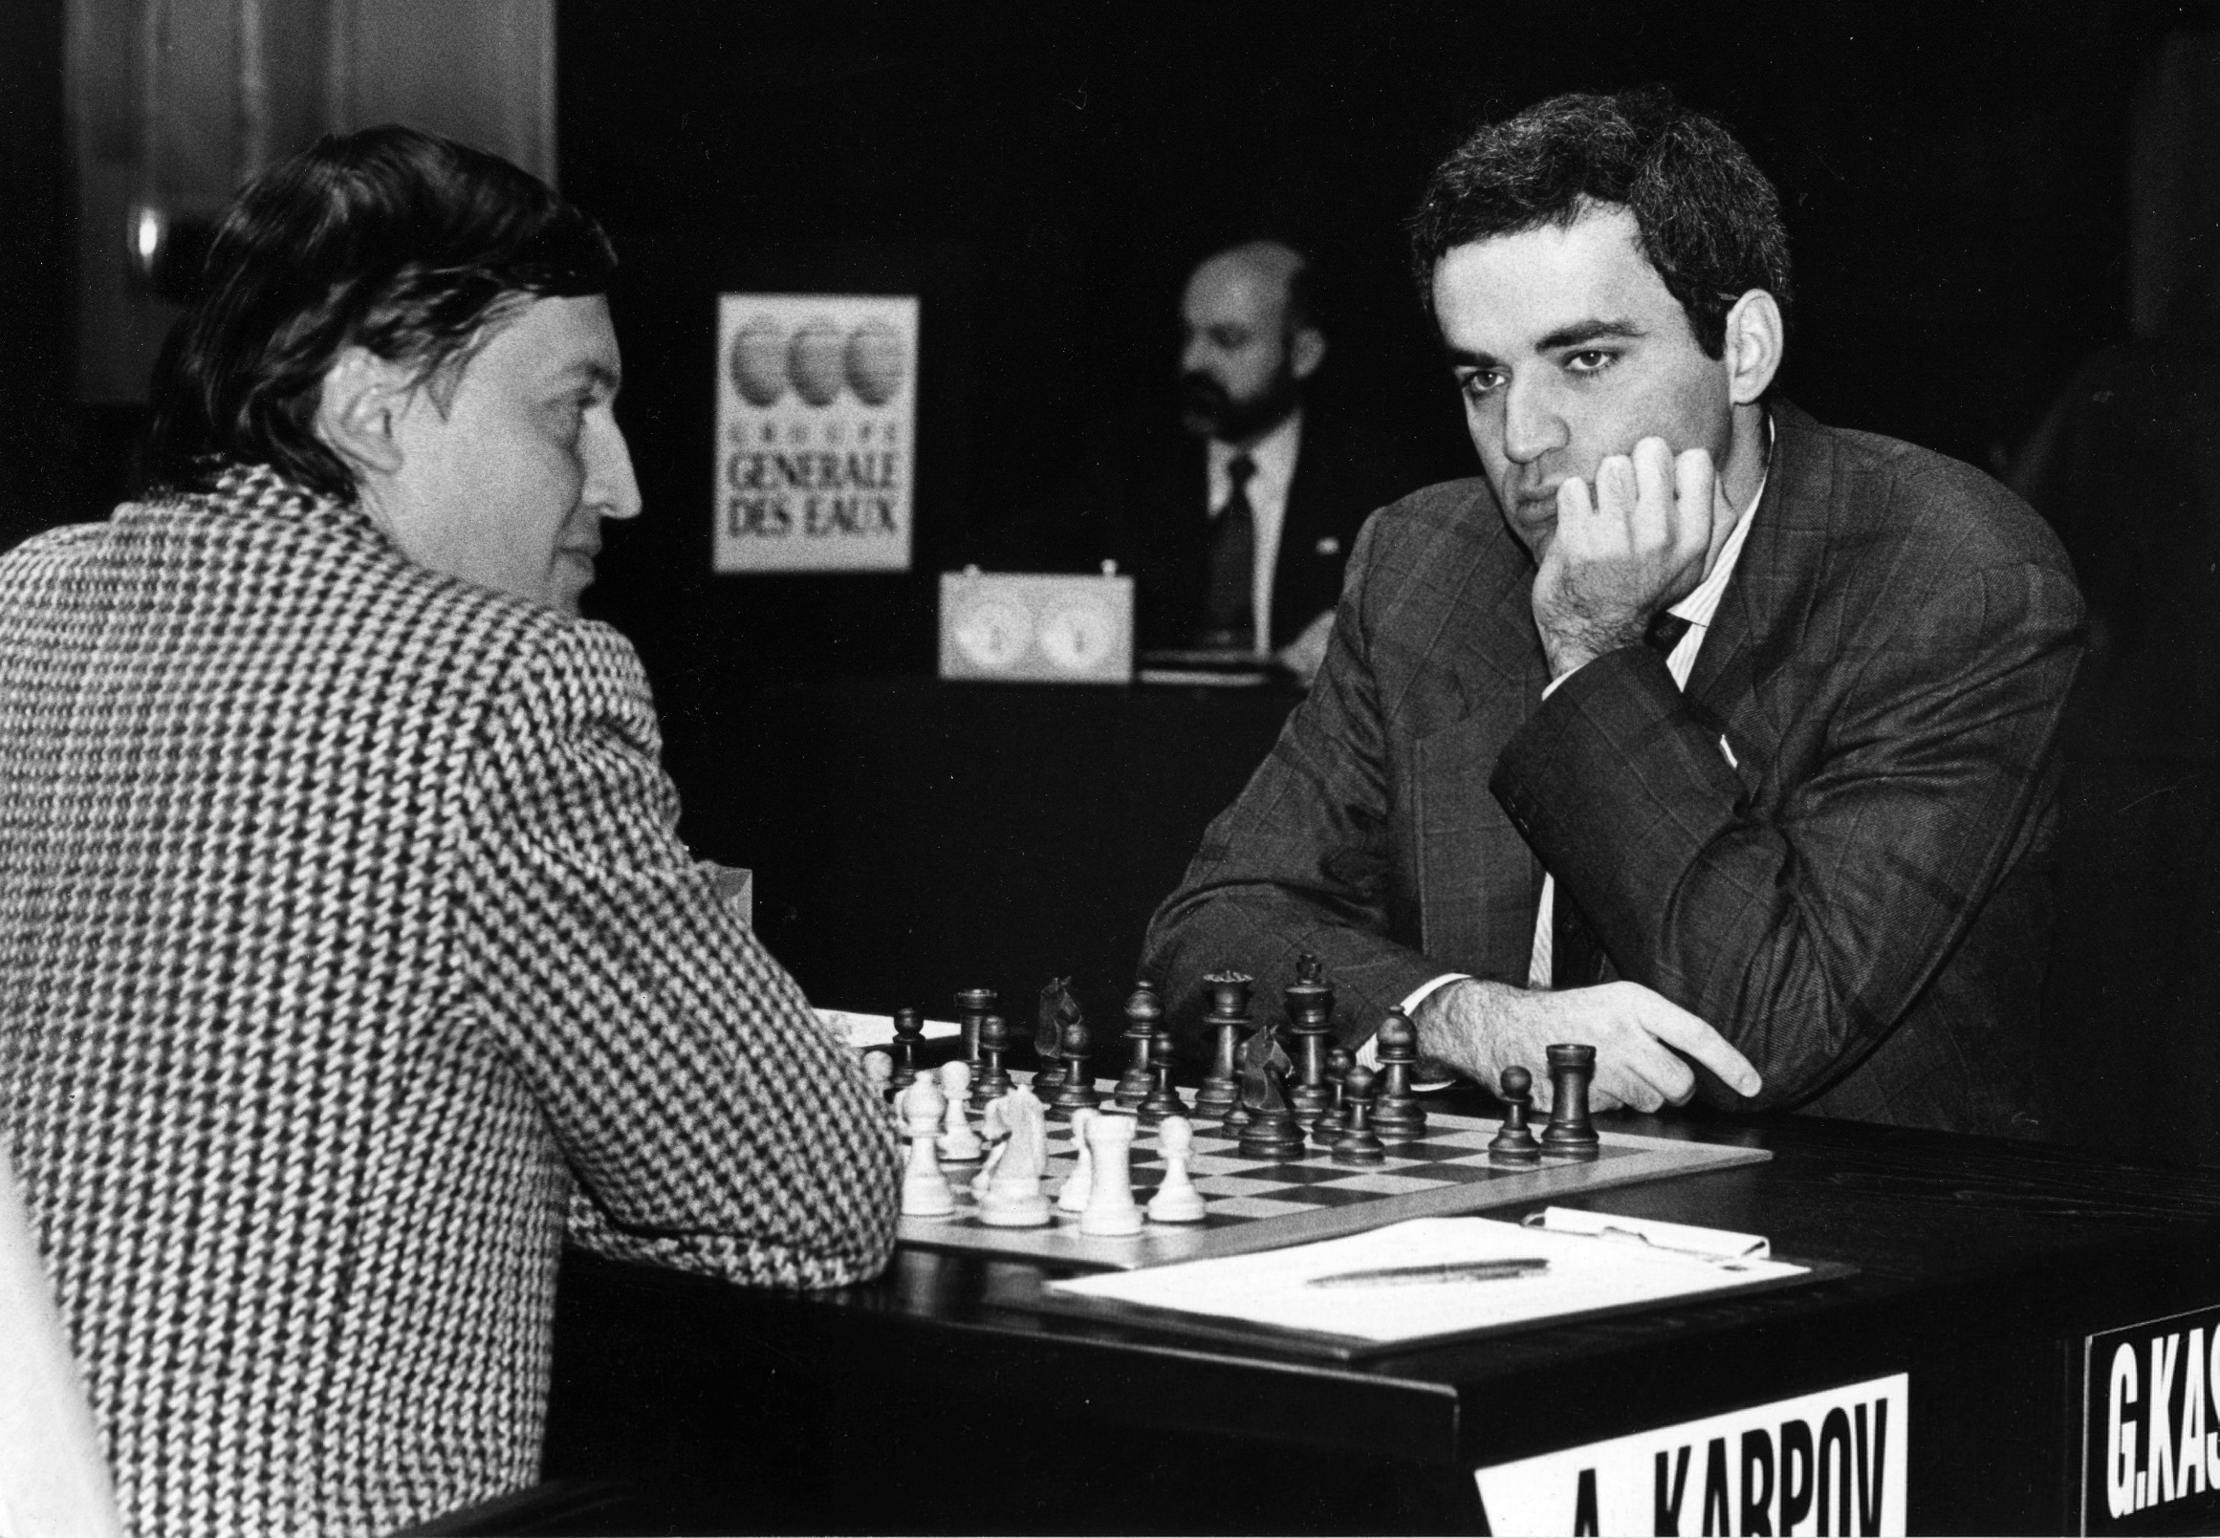

Slide 2


School of Engineering Technology and Applied Science
The Machine Learning Process
using a decision tree model
Reza Dibaj August 2018

Slide 3
Outline
What is Machine Learning? Difference between apple and orange
What is Classifier?
Supervised Learning Recipe
Collect Training Data
Train Classifier
Make Predictions

Slide 4
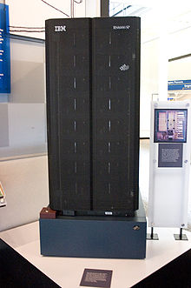
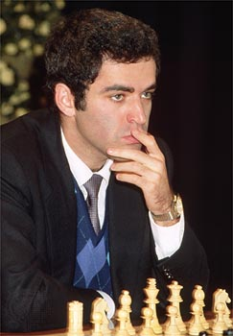
What is Machine Learning?
Subfield of Artificial Intelligence (AI)
Early AI programs typically excelled at one specific task
e.g. Deep Blue (chess computer)
VS
IBM Deep Blue
Garry Kasparov

Slide 5
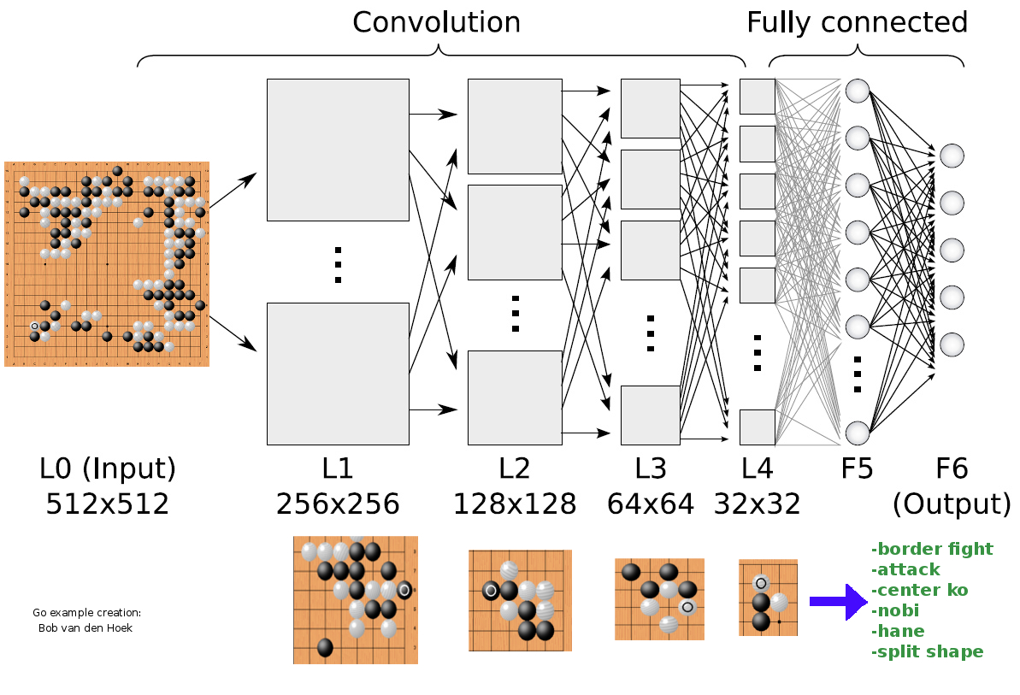
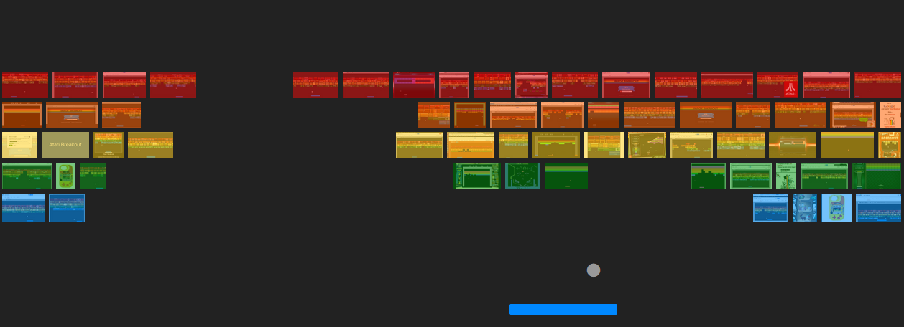

What is Machine Learning?
Writing one program that can solve a number of problems without needing to be rewritten
Notes:
We want to write one program that can solve many problems without needing to be rewritten

Slide 6

What is Machine Learning?
Machine Learning: algorithms that learn from examples and experience, instead of relying on hard-coded rules

Slide 7


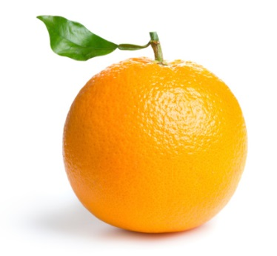
Difference between apple and orange
Write a program to take an image file as input, does some analyses, and output the type of fruit:
“Apple”
“Orange”

Slide 8

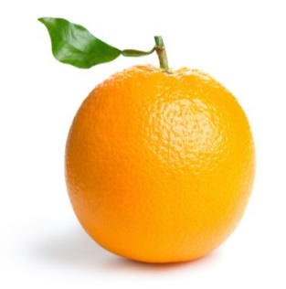
Difference between apple and orange
Counting the number of orange pixels and green pixels
Calculate the ratio
def detect_colors(image):
# lots of code
def detect_edges(image):
# lots of code
def analyse_shapes(image):
# lots of code
def guess_texture(image):
# lots of code
def define_fruit(image):
# lots of code
def handle_probability(image):
# lots of code

Slide 9
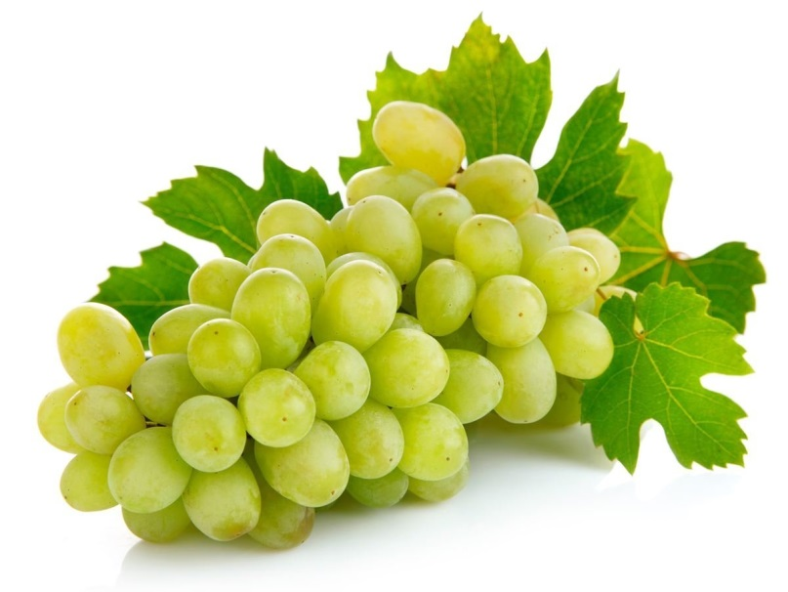
Difference between apple and orange
How about writing a program to handle black-and-white photo?
How about the images that contain other types of fruit?
?
?
Notes:
That works fine for simple images like these. But as you dive deeper into the problem, you will find the real world is messy, and the rules you write start to break.
How about writing a program to handle black-and-white photo?
How about the images that contains other types of fruits?

Slide 10

What is Classifier?
Machine Learning is all about the algorithms that can define these rules for us.
For that we are going to train a classifier.
f(x) = y
“Spam”
“Apple”
Features
Label
Notes:
Clearly we need something better. To solve this, we need an algorithm that can figure out the rules for us, so we do not have to write them by hand.
And for that we are going to train a classifier.
For now, you can think of a classifier as a function.
Classifier is similar to a function that takes some data as input and assigns label to it as output.

Slide 11
What is Classifier?
The technique to write the classifier automatically is called Supervised Learning.
It begins with examples of a problem you want to solve by finding patterns in these examples.
Notes:
Diff from clustering

Slide 12
What is Classifier?
What does it mean to learn from data?
f(x) = y
Features
Label
def Classify(features):
# do some logic
return label
Notes:
Earlier, we mentioned that we call the features X and the labels Y, as they were the input and output of a function.
As we already know in supervised learning, we do not want to write this function ourselves. We want an algorithm to learn it from training data.
So, what is it mean to learn a function?

Slide 13
What is Classifier?
What could the body of the function look like?
def Classify(features):
# do some logic
return label
Notes:
What could the body of the function look like?
That is the part that we want to write algorithmically, or in other words learn.
The important thing to understand here is we are not starting from the scratch and pulling the body of the function out of thin air. Instead, we start with a model.
You can think of a model as the prototype for or the rules that define the body of our function.

Slide 14
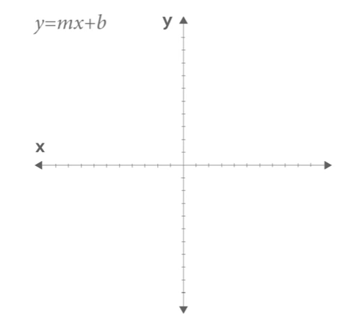
What is Classifier?
What does it means to learn a function?
Notes:
So, what does it mean to learn a function?
Function is just a mapping from input to output values.
Here is a function you might have seen before:
y = mx+b
That is the equation for a line, and there are two parameter: m which gives you the slope; and b, which gives you the y-intercept.
Given these parameters, of course, we can plot the function for different values of x.
In supervised learning, our classified function might have some parameters as well.
But the input x are the features that we want to classify, and the output y is a label, like Spam or Not Spam, or type of a flower.

Slide 15
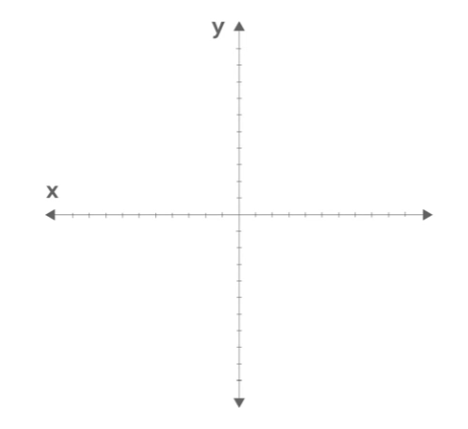
What is Classifier?
Distinguishing between red dots and green dots:
Notes:
Typically, a model has parameters that we can adjust with our training data.
And here is a high-level example of how this process works.
Let’s look at a toy dataset and think about what kind of model we could use as a classifier.
Pretend we are interested in distinguishing between red dots and green dots, some of which I have drawn here on a graph. To do that we will use just two features: the x and y coordinate of a dot.

Slide 16
What is Classifier?
How can we classify any data?
Red or green?
Notes:
Now let’s think about how we could classify this data. We want a function that considers a new dot that has never seen before, and classifies it as red or green.
In fact, there might be a lot of data we want to classify.

Slide 17
What is Classifier?
How can we classify any data?
Classifier
Notes:
Imagine if we could somehow draw a line across the data.
Then we could say the dots to the left of the line are green and the dots to the right of the line are red.
The question is: How can we learn this line?

Slide 18
What is Classifier?
How could we learn the right parameters?
One idea is that we can iteratively adjust the parameters using the training data
Notes:
For example, we might start with a random line and use it to classify the first training example. If it gets it right, we do not need to change our line, so we move on to the next one.
But on the other hand, if it gets wrong, we can slightly adjust the parameters of our model to make it more accurate.
The takeaway here is this: One way to think of learning is using training data to adjust the parameters of a model.

Slide 19


Supervised Learning Recipe
scikit-learn
Click here for more info
TensorFlow
Click here for more info
Go to the installation part
Notes:
Six lines of code is all it takes to write your first Machine Learning program.
We can use ML for two things:
Predications
Describing current situation we are in
Scikit-learn is most basic form of ML like decision-tree
Tensorflow nortorious for complicated e.g. deeplearning and neural networks

Slide 20
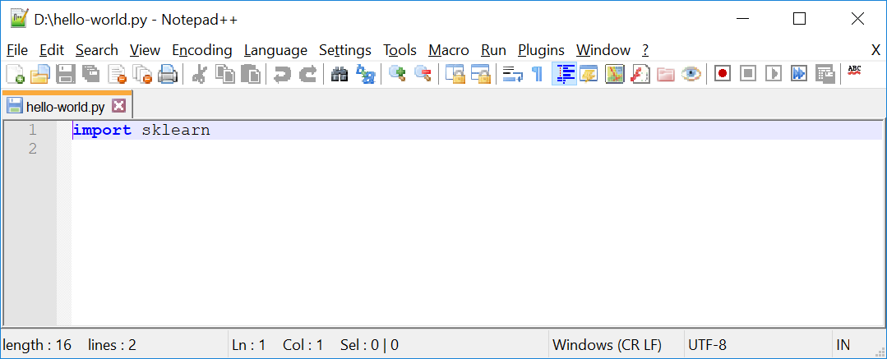
Supervised Learning Recipe
Now create a file, named hello-world.py as follows:
Notes:
Hello-world.py
import sklearn
Command line:
python hello-world.py

Slide 21
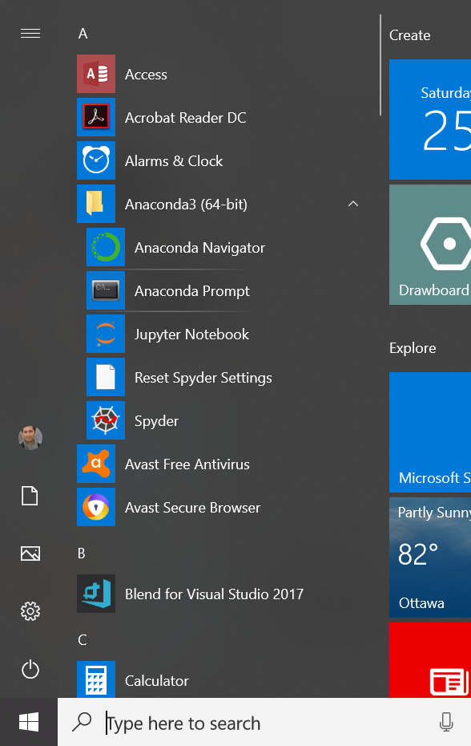
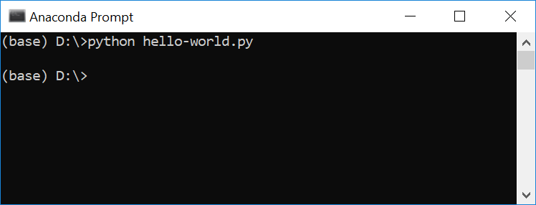
Supervised Learning Recipe
Go to your program and open your Anaconda3 (64bits) and then Anaconda prompt. After that go to the directory that you have created your hello-world.py and type: python hello-world.py↵
Notes:
Hello-world.py
import sklearn
Command line:
python hello-world.py

Slide 22
Supervised Learning Recipe
Collect Training Data
Training Classifier
Make Predictions

Slide 23
Supervised Learning Recipe
Collect Training Data
Training Classifier
Make Predictions

Slide 24
Supervised Learning Recipe
Collect Training Data
The more data we have, the better classifier we can make.
Features
Weight | Texture | Label
150g | Bumpy | Orange
170g | Bumpy | Orange
140g | Smooth | Apple
130g | Smooth | Apple
… | … | …
Examples
Notes:
Imagine we head out to an orchard.
Data pruning: we may need to identify which features are useful and eliminate useless ones

Slide 25
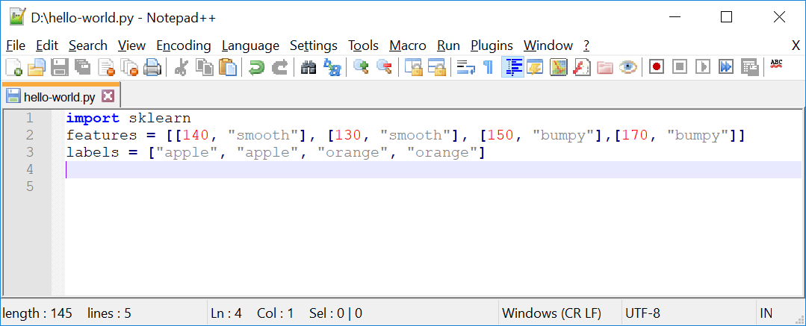
Supervised Learning Recipe
Collect Training Data
Let’s get back to our “hello-world.py” file:
Input
Output
Notes:
import sklearn
features = [[140, "smooth"], [130, "smooth"], [150, "bumpy"],[170, "bumpy"]]
labels = ["apple", "apple", "orange", "orange"]

Slide 26
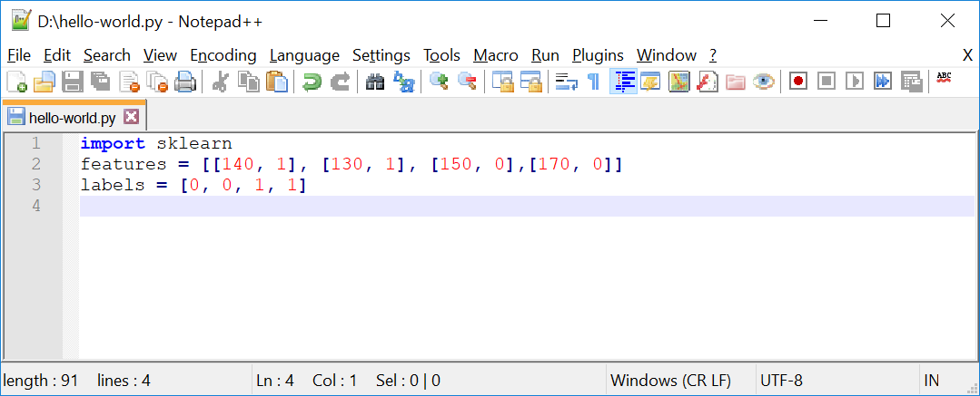
Supervised Learning Recipe
Collect Training Data
Replacing features and labels with integer values.
Input
Output
Notes:
import sklearn
features = [[140, 1], [130, 1], [150, 0],[170, 0]]
labels = [0, 0, 1, 1]

Slide 27
Supervised Learning Recipe
Training Classifier
Training classifier using a decision tree model:
Collect Training Data
Training Classifier
Make Predictions

Slide 28
Supervised Learning Recipe
Training Classifier
We use Decision Tree as our classifier and let’s assume it as a box of rules for now.
Weight > 150g?
Yes
No
Texture = bumpy?
Yes
No
Orange
Apple

Slide 29
Supervised Learning Recipe
Training Classifier
We have different classifiers, and decision tree is one of them.
160g Bumpy
“Orange”
Notes:
Different classifiers:
Linear Classifiers: Logistic Regression, Naive Bayes Classifier
Support Vector Machines (SVM)
Decision Trees
Boosted Trees
Random Forest
Artificial Neural Networks (ANN)
Nearest Neighbor

Slide 30
Supervised Learning Recipe
Training Classifier
Why Decision Tree?
Easy to read and understand
One of the few models that are interpretable
Notes:
A trick to build an effective tree is to understand which question to ask and when.
And to do that we need to quantify how much a question helps to un-mix the labels.
Gini Impurity: We can quantify the amount of uncertainty at a single node
Information gain: We can quantify how much a question reduces that uncertainty.
We use these two above parameters to find the best question to ask at each point and given that question we will recursively build the tree on each of the new nodes.
We continue building the data until there are no further questions to ask, at which point we will be at leaf.

Slide 31
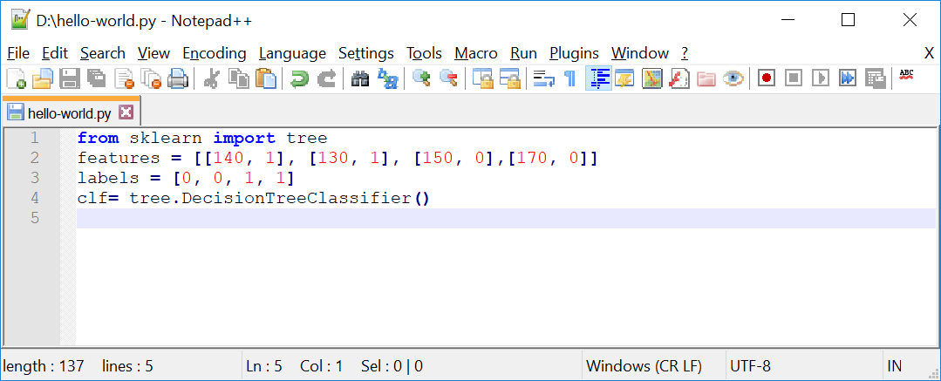
Supervised Learning Recipe
Training Classifier
At this point we define a classifier which is a box of rules. It does not know anything about “apple” and “orange” yet. To train it we need a learning algorithm.
Notes:
from sklearn import tree
features = [[140, 1], [130, 1], [150, 0],[170, 0]]
labels = [0, 0, 1, 1]
clf= tree.DecisionTreeClassifier()

Slide 32



Supervised Learning Recipe
Training Classifier
If we consider a classifier as a box of rules, then we can assume a learning algorithm as the procedure that creates those rules. It does that by finding patterns in our training data.

Slide 33
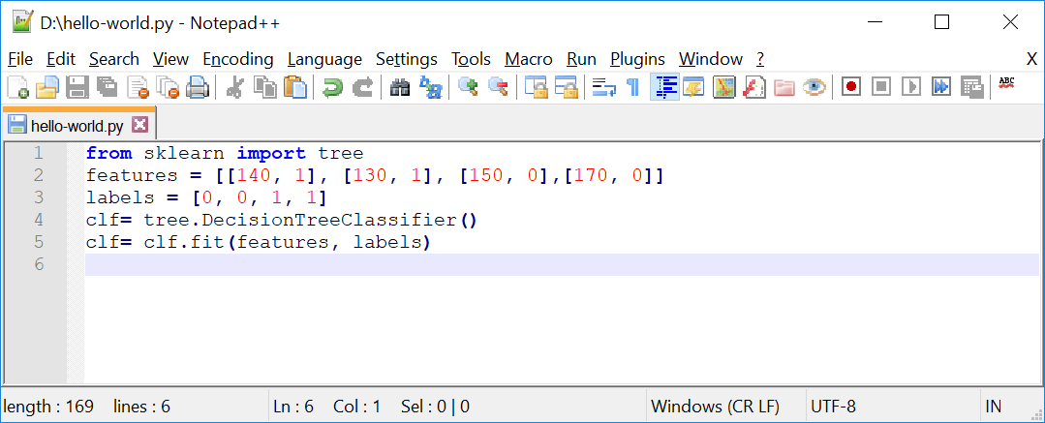
Supervised Learning Recipe
Training Classifier
In scikit the training algorithm is included in the classifier object and is called fit, which is finding patterns in data.
Notes:
Important: We can think of fit as find patterns in data.
We will get into details of how this happens under the hood in a future presentation.
from sklearn import tree
features = [[140, 1], [130, 1], [150, 0],[170, 0]]
labels = [0, 0, 1, 1]
clf= tree.DecisionTreeClassifier()
clf= clf.fit(features, labels)

Slide 34
Supervised Learning Recipe
Make Predictions
Collect Training Data
Training Classifier
Make Predictions

Slide 35
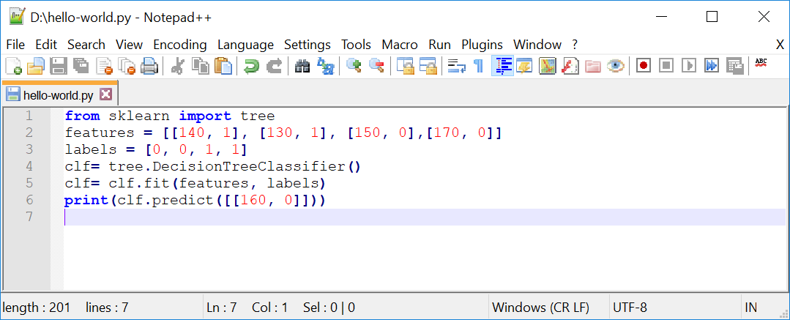
Supervised Learning Recipe
Make Predictions
Now its time to make a prediction. So let’s take it for a spin and use it to classify a new fruit. What is your guess in this example?
Notes:
from sklearn import tree
features = [[140, 1], [130, 1], [150, 0],[170, 0]]
labels = [0, 0, 1, 1]
clf= tree.DecisionTreeClassifier()
clf= clf.fit(features, labels)
print(clf.predict([[160, 0]]))

Slide 36
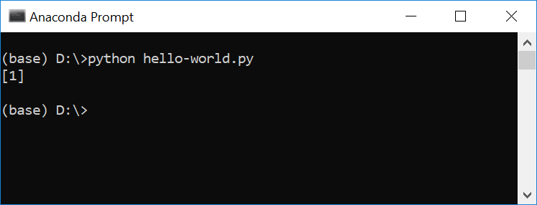
Supervised Learning Recipe
Make Predictions
That is true, as it is bumpy and heavier, it should be orange or 1.

Slide 37
Supervised Learning Recipe
Using the same program for a new problem
Defining a new classifier for a new problem, by changing the training data
Far more reusable than writing new rules for each problem
The more data we have, the better classifier we can make
Horsepower | Seat | Label
300 | 2 | sport-car
450 | 2 | sport-car
200 | 8 | minivan
150 | 9 | minivan
… | … | …
Notes:
This makes this approach far more reusable than writing new rules for each problem.

Slide 38

Thank you
Question?
To be
Not to be

Slide 39
Appendix:
Installation Process
Notes:
Six lines of code is all it takes to write your first Machine Learning program.

Slide 40
Open Source Libraries That We Use
scikit-learn
Click here for more info
TensorFlow
Click here for more info

Slide 41
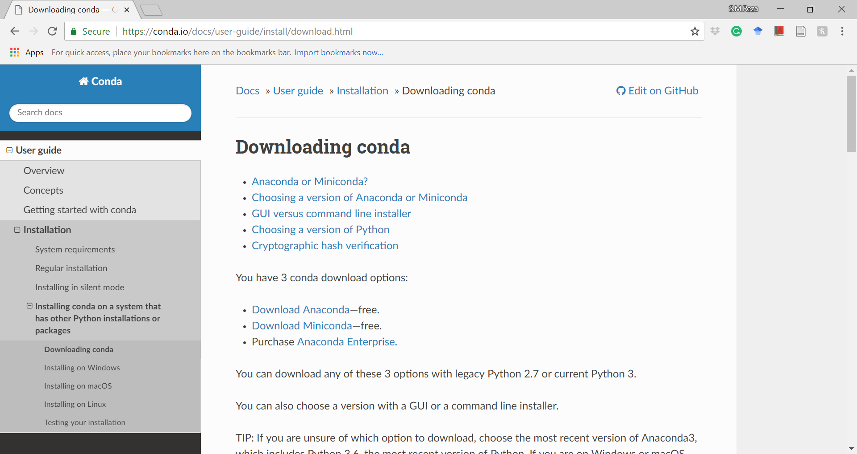
Installation Process
Going to https://conda.io/docs/user-guide/install/download.html and clicking on the Download Anaconda link.

Slide 42
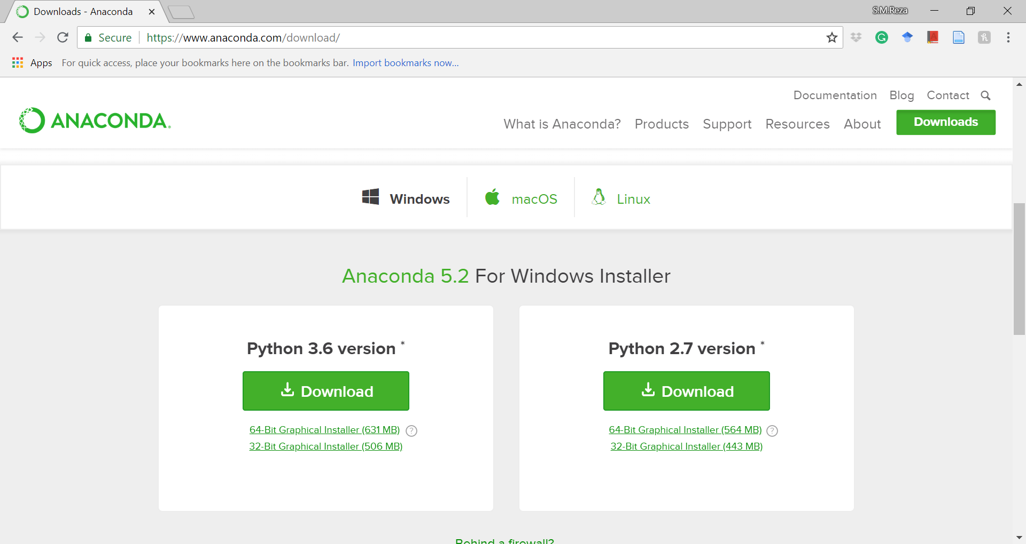
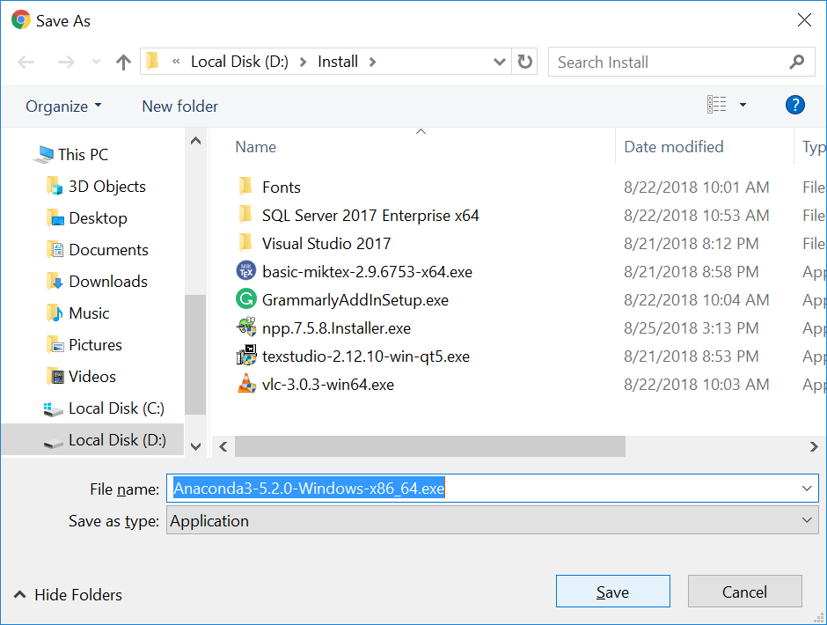
Installation Process
Clicking on 64-Bit Graphical Installer (631 MB) to install Python and over 150 scientific packages.

Slide 43
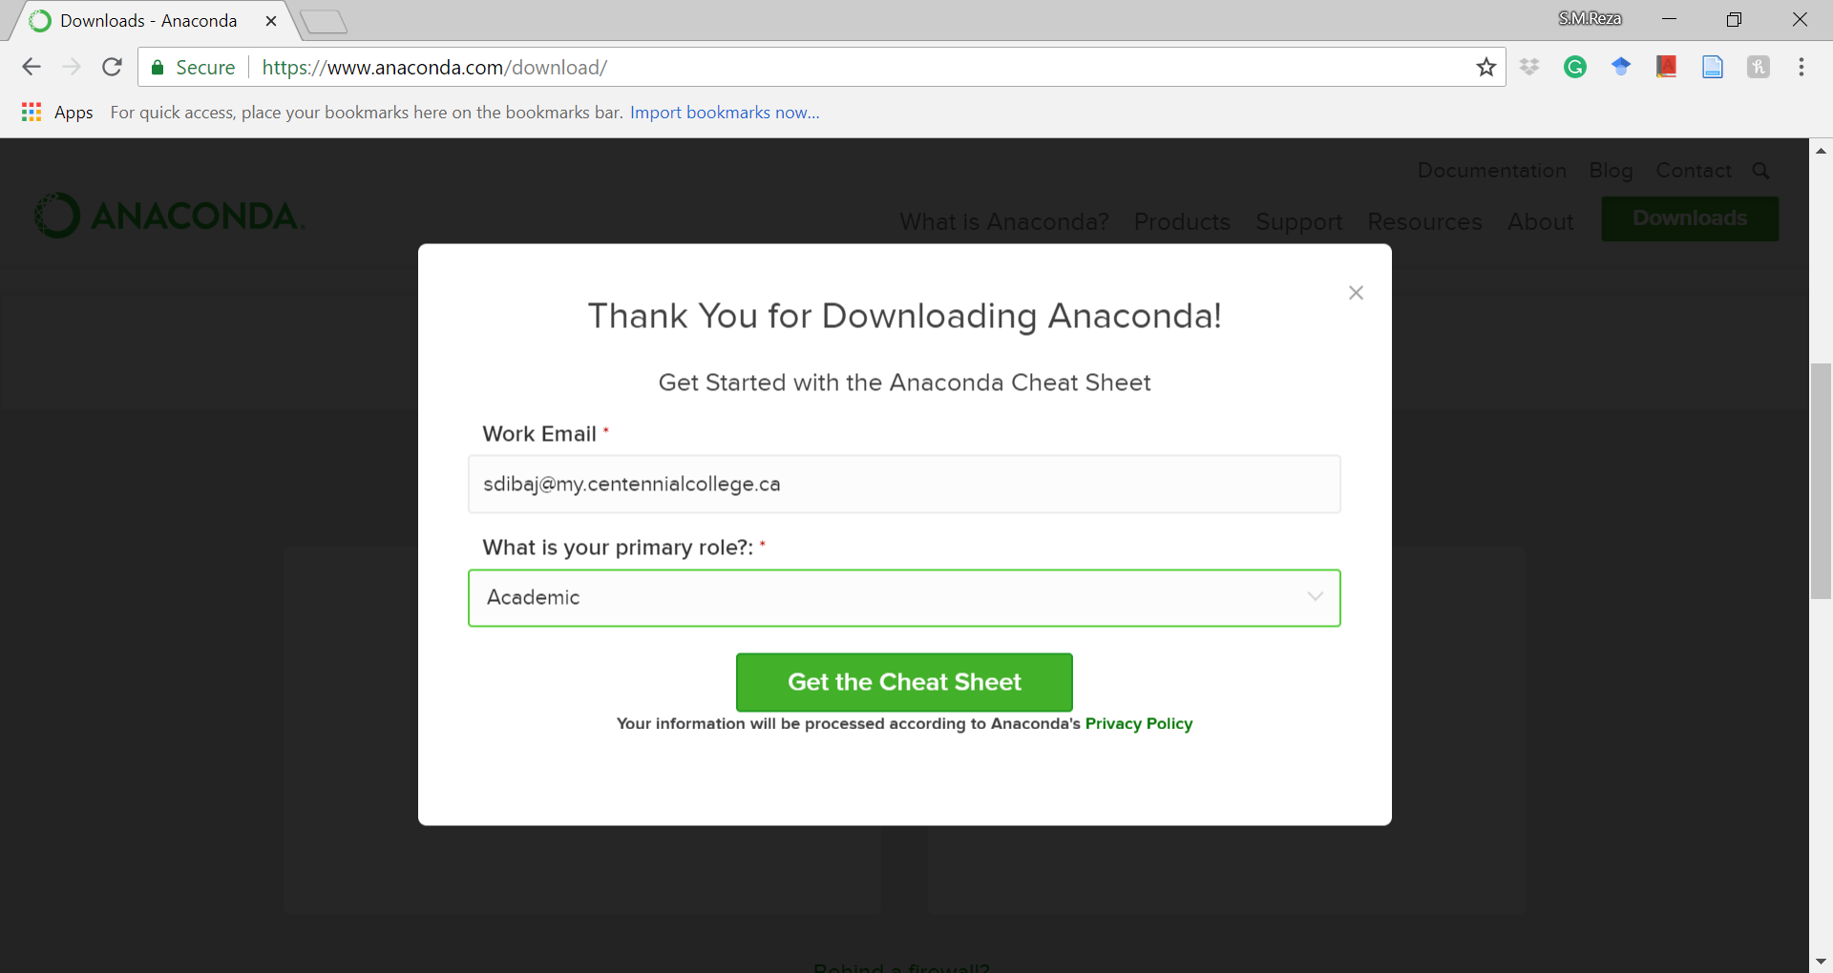
Installation Process
To get more help from the website you can register in the following popup window:

Slide 44
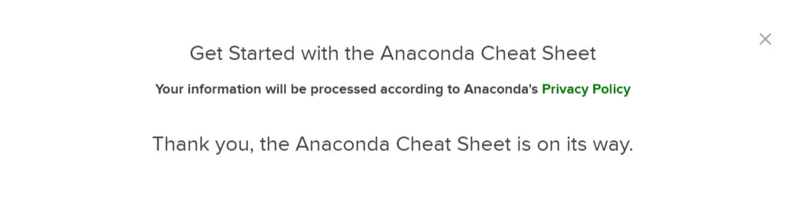
Installation Process
This is the confirmation message that you will receive after registration.

Slide 45
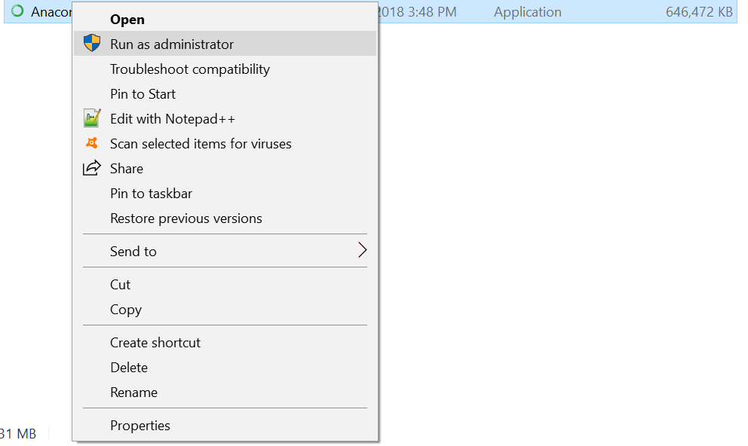

Installation Process
Right click on the downloaded file and choose Run as administrator:

Slide 46
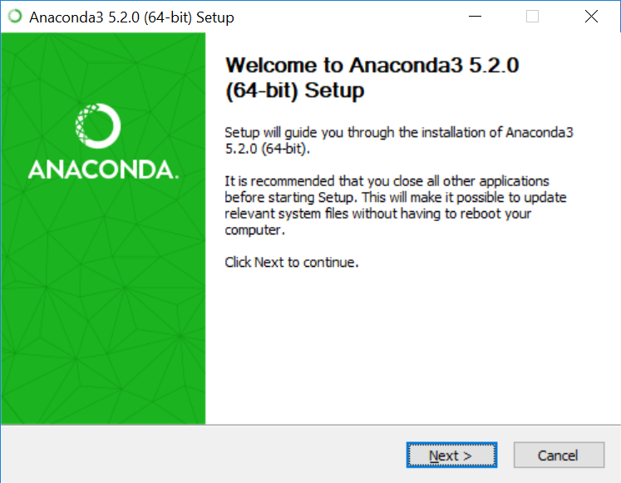
Installation Process
Start the installation process by pressing the next button:

Slide 47
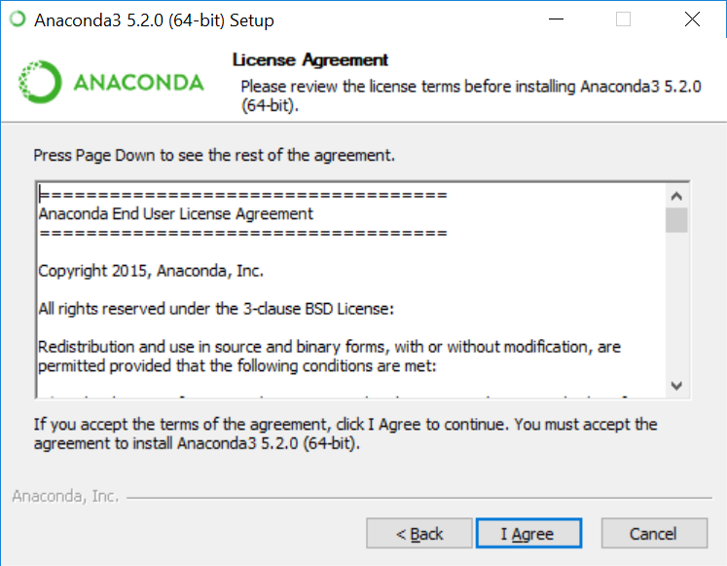
Installation Process
Confirm the license agreement by pressing the I Agree button:

Slide 48
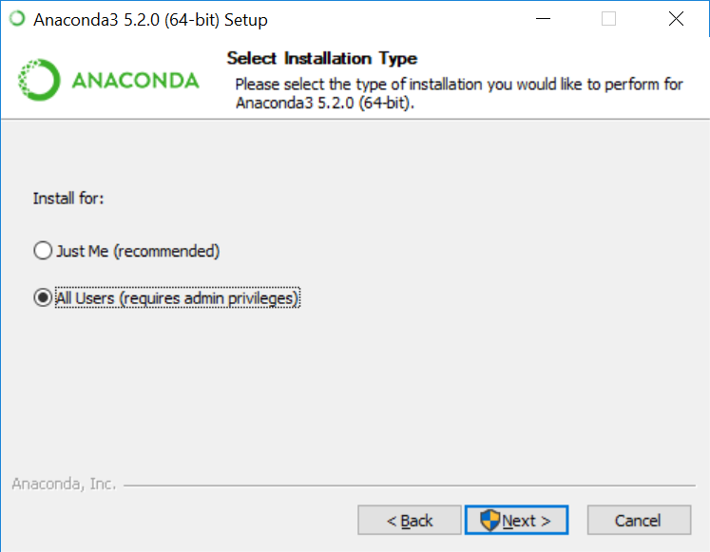
Installation Process
Choose either of the options that suits your needs and press the next button:

Slide 49
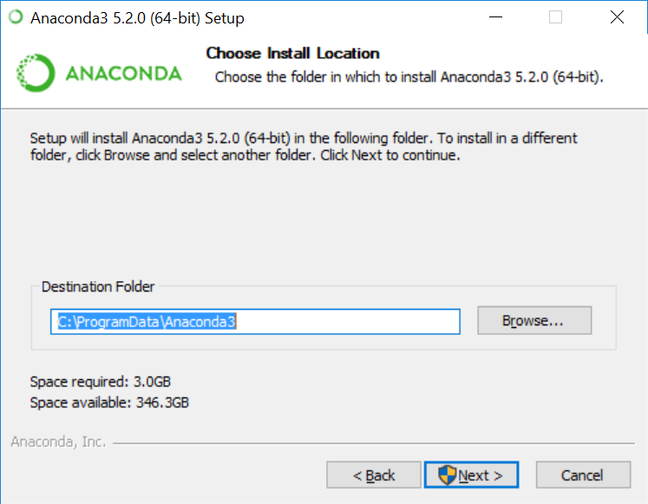
Installation Process
Choose the location that you want to install and press the next button:

Slide 50
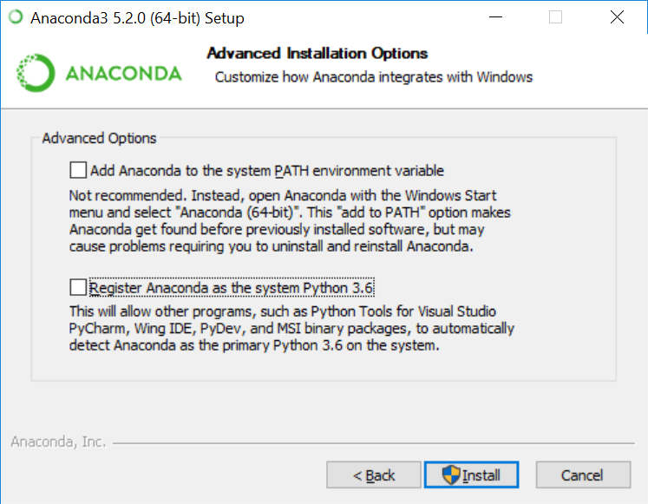
Installation Process
Press the Install button without checking any of the checkboxes:

Slide 51
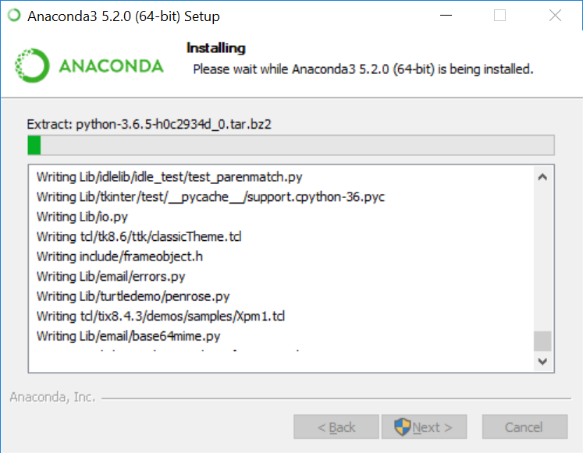
Installation Process
Installation in progress…

Slide 52
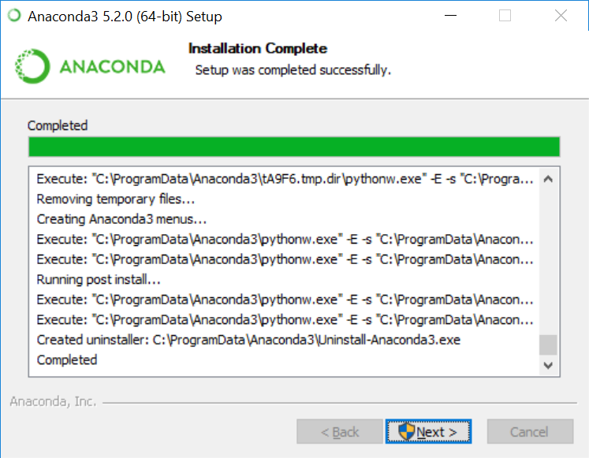
Installation Process
Press the next button to continue:

Slide 53
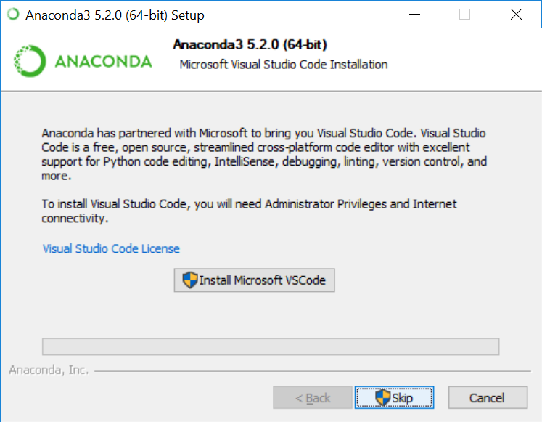
Installation Process
Install Microsoft VSCode if you like to use a streamlined cross-platform code editor:

Slide 54
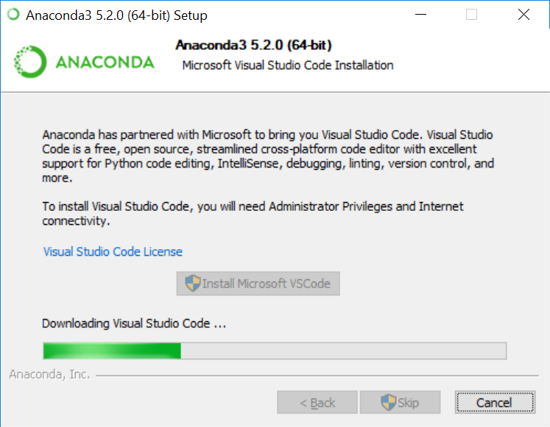
Installation Process
Downloading and installing Microsoft Visual Studio Code…

Slide 55
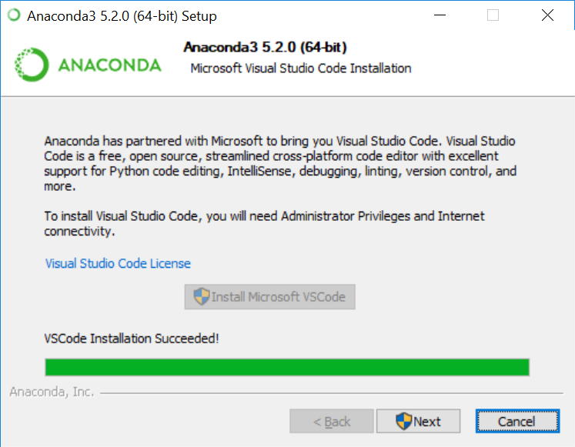
Installation Process
Press the next button to continue:

Slide 56
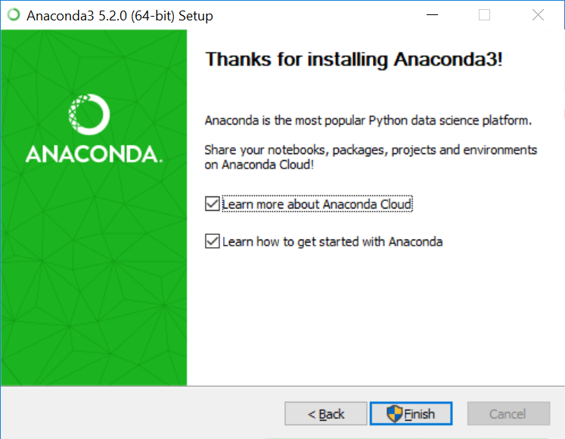
Installation Process
Press the finish button to finish the installation:

Slide 57
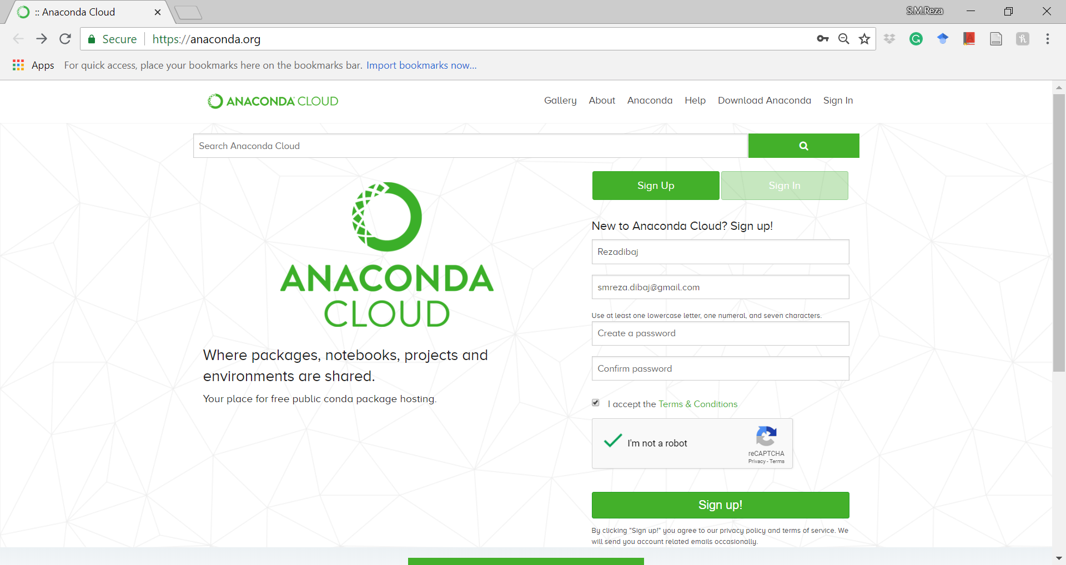
Installation Process
Registering into the Anaconda Cloud:

Slide 58
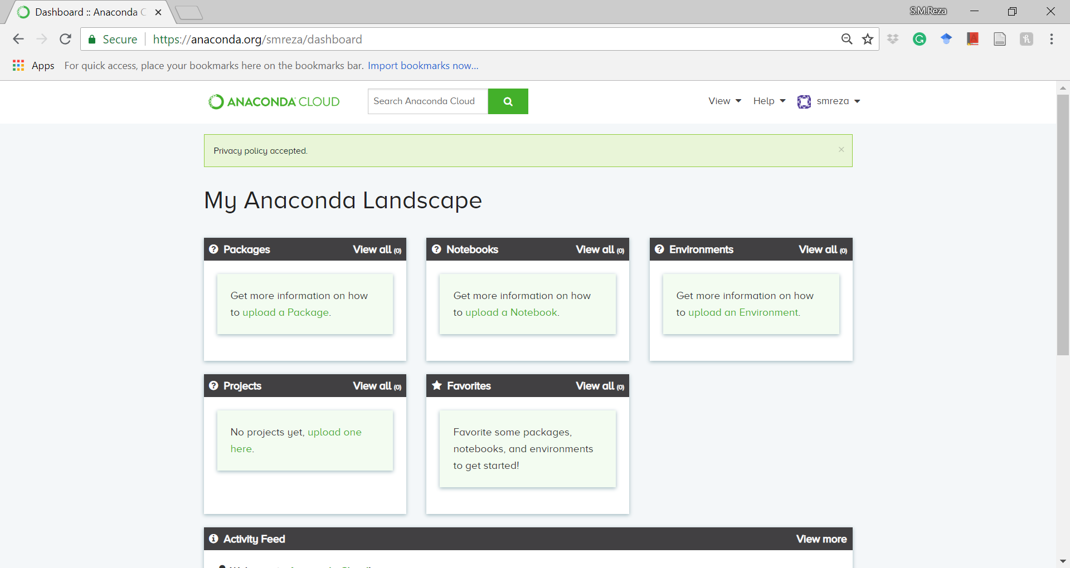
Installation Process
Inside the Anaconda Cloud:

Slide 59
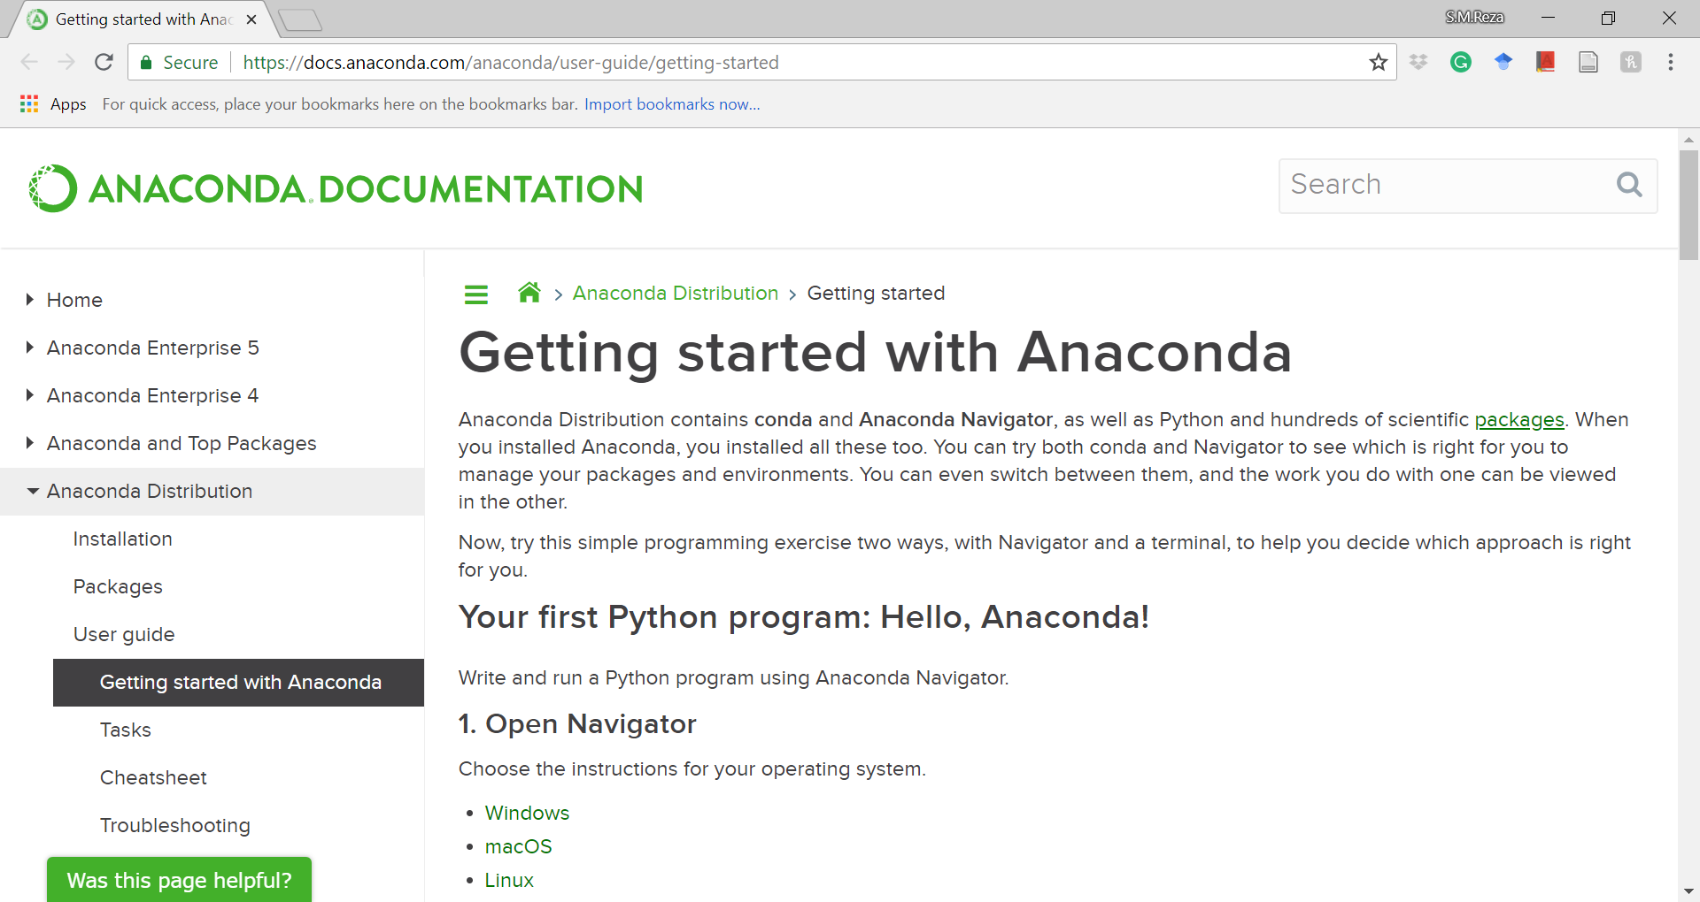
Installation Process
Information about Anaconda using the following URL:
https://docs.anaconda.com/anaconda/user-guide/getting-started

